Slide 1
CONFLICT AND COHESION
IN GROUPS
Group 6:
Nguyen Tran Phong
Vo Van Thanh Phuc
Nguyen Tuan Anh

Slide 2
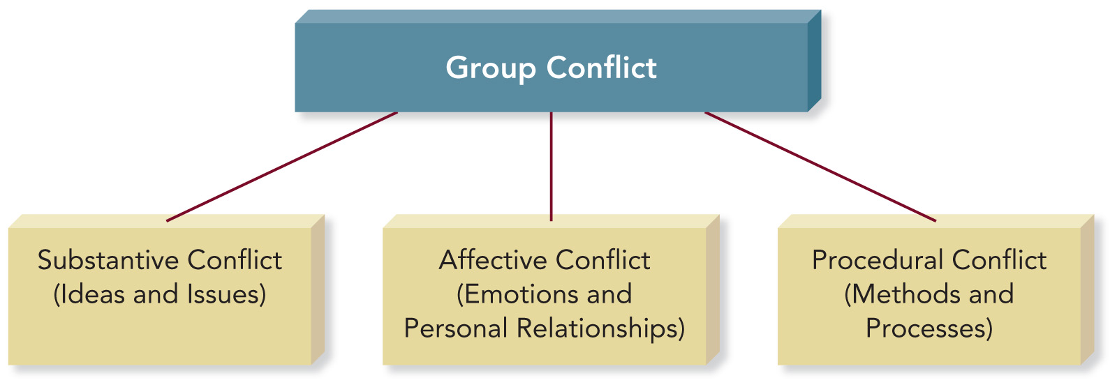
1. CONFLICT IN GROUPS
Conflict is frequently associated with fighting, anger, and hostility.
Definition of conflict: The disagreement and disharmony that occur in groups when members express differences regarding group goals; member ideas, behavior, and roles; or group procedures and norms.

Slide 3

1.1 SUBSTANTIVE CONFLICT
Substantive conflict occurs when members disagree about issues, ideas, decisions, actions, or goals.

Slide 4
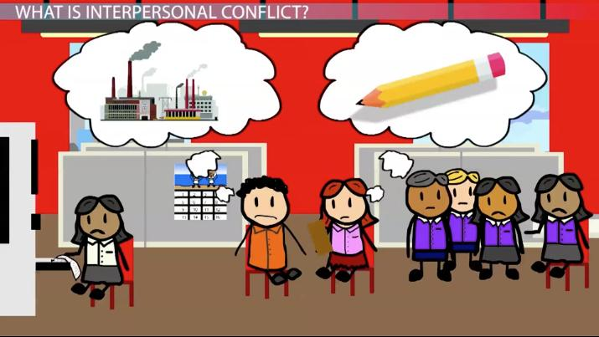
1.2 AFFECTIVE CONFLICT
Affective conflict is the result of interpersonal disagreements, differences in personalities and communications styles, and members’ conflicting core values and beliefs.
“This often leads to avoidance. The parties in the conflict begin to seek ways to do their work without having to interact” (Gastil J., The Group in Society, p.177).

Slide 5
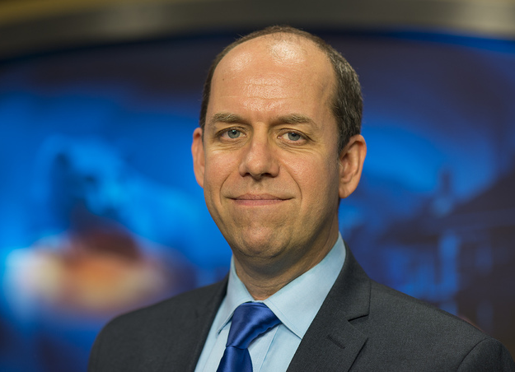
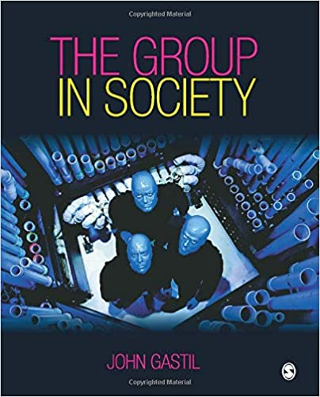
1.2 AFFECTIVE CONFLICT
“This often leads to avoidance. The parties in the conflict begin to seek ways to do their work without having to interact”
(Gastil J., The Group in Society, p.177)

Slide 6
1.3 PROCEDURAL CONFLICT
Prodecural conflict is disagreement among group members about the method or process the group uses in its attempt to accomplish a goal.

Slide 7


